Slide 1


Intelligent Engineering with AI
Welcome to the Course
Objectives Overview
Learn to elevate your software engineering practices by integrating Test-Driven Development (TDD) with cutting-edge AI tools like GitHub Copilot and ChatGPT.
Notes:
(9:00 - 9:05) 5 minutes
**Welcome to the Course**
- Welcome participants to the course "Intelligent Engineering with AI."
- Introduce yourself and any co-instructors.
- Provide a brief overview of the agenda for the day.
**Course Summary**
- "Learn to elevate your software engineering practices by integrating Test-Driven Development (TDD) with cutting-edge AI tools like GitHub Copilot and ChatGPT."
**Objectives Overview**
- Explain the main objectives of the course:
- **Integrating TDD and AI Tools**: Discuss how Test-Driven Development (TDD) and AI tools like GitHub Copilot and ChatGPT can enhance software development practices.
- **Hands-On Learning**: Emphasize the importance of practical exercises and real-world applications.
- **Software Craftsmanship**: Highlight the focus on software craftsmanship principles to produce high-quality, maintainable code.
**Additional Points to Cover:**
- Discuss the importance of active participation and engagement.
- Mention any logistics (breaks, schedule, Q&A sessions).
- Encourage participants to share their backgrounds and expectations for the course in the next slide.

Slide 2

Instructor Introduction
Get to know your instructor, an experienced software engineer specializing in TDD and AI integration.
Notes:
(9:05 - 9:10) 5 minutes
**One Sentence Summary**
- "Get to know your instructor, an experienced software engineer specializing in TDD and AI integration."
**Detailed Notes:**
- Introduce yourself and provide a brief background:
- **Experience**: Mention your years of experience in software engineering, focusing on Test-Driven Development (TDD) and AI tools.
- **Expertise**: Highlight your expertise in integrating AI tools like GitHub Copilot and ChatGPT into traditional coding practices.
- **Professional Journey**: Share a quick overview of your career path and notable projects or companies you've worked with.
- Explain your role in the course:
- **Guidance**: Describe how you will guide participants through the course material and exercises.
- **Support**: Emphasize your availability for questions and discussions throughout the course.
**Background Information:**
- **Test-Driven Development (TDD)**:
- **History**: TDD was popularized by Kent Beck as part of the Extreme Programming (XP) methodology in the late 1990s. It emphasizes writing tests before writing the actual code to ensure functionality and drive design.
- **Importance**: TDD helps in maintaining a high-quality codebase by ensuring that every piece of code is tested, leading to fewer bugs and easier maintenance.
- **AI in Software Development**:
- **Evolution**: AI tools like GitHub Copilot, which uses OpenAI's Codex model, have emerged in recent years to assist developers by providing code suggestions, autocompletion, and even generating entire functions based on comments or prompts.
- **Integration**: The integration of AI into software development workflows can significantly enhance productivity by automating routine coding tasks and providing intelligent assistance, allowing developers to focus on more complex and creative aspects of development.
**Example:**
- **Personal Anecdote**:
- "In a recent project, I used TDD and AI tools to solve various problems and put together an API project. GitHub Copilot was particularly helpful in providing regular expressions, solving simple problems, and showing me how to implement features in languages I wasn't familiar with or had recently switched to. The autocomplete functionality saved a lot of time and streamlined the development process. By integrating these technologies, I was able to efficiently build a robust API."

Slide 3

Participant Introductions and Backgrounds
Share your background
Experience with TDD and AI
Notes:
(9:10 - 9:20) 10 minutes
**One Sentence Summary**
- "Participants share their backgrounds and experience levels to tailor the course content effectively."
**Detailed Notes:**
- **Introduction**:
- Explain the importance of understanding participants' backgrounds to tailor the course content to their needs.
- Encourage everyone to be open and share their experiences to create a collaborative learning environment.
- **Background**:
- Ask participants to introduce themselves, including:
- Their current role and experience in software development.
- Any prior experience with Test-Driven Development (TDD).
- Familiarity with AI tools like GitHub Copilot and ChatGPT.
- **Discussion Points**:
- **TDD Experience**:
- If participants have used TDD before, ask about their experiences and challenges.
- If they are new to TDD, ask what they hope to learn and achieve.
- **AI Tools Experience**:
- For those familiar with AI tools, ask how they have integrated these tools into their workflows.
- For newcomers, discuss their expectations and what specific AI capabilities they are interested in exploring.
- **Goals and Expectations**:
- Encourage participants to share their goals for the course and what they hope to take away from it.
- Use this information to highlight relevant sections of the course that will meet their needs and interests.
**Background Information:**
- **TDD**:
- TDD is a software development approach where tests are written before the code. This method ensures that the code meets the requirements and helps in identifying bugs early.
- **AI Tools**:
- AI tools like GitHub Copilot and ChatGPT can assist in various aspects of coding, from generating code snippets to providing debugging assistance. These tools help streamline the development process and increase productivity.
**Example**:
- **Participant Story**:
- Share an example of how previous participants have benefited from sharing their backgrounds. For instance, "In a previous session, we had a mix of experienced developers and beginners. By understanding everyone's background, we could pair up participants for hands-on exercises, resulting in a highly collaborative and effective learning experience."

Slide 4

Overview of Tyler Morgan’s Role
https://chatgpt.com/g/g-m8zONvdCL-leandog-intelligent-engineering-with-ai
Notes:
(9:20 - 9:25) 5 minutes
**One Sentence Summary**
- "Understand how Tyler Morgan, the Intelligent Engineering Course Assistant, will support your learning journey."
**Detailed Notes:**
- **Introduction**:
- Introduce Tyler Morgan as the course assistant and explain their role in supporting the course.
- Highlight the unique value Tyler brings to the course through their expertise and use of AI tools.
- **Role Description**:
- **Course Material Assistance**: Explain that Tyler will assist with course material, including explaining concepts and guiding exercises.
- **Expert Advice**: Tyler will provide expert advice on software engineering practices, particularly focusing on TDD and AI integration.
- **Real-time Support**: Emphasize that Tyler will be available for real-time support throughout the course, answering questions and providing insights.
- **AI Tools Integration**:
- **Leveraging AI**: Discuss how Tyler will leverage AI tools like ChatGPT to enhance the learning experience.
- **Examples**: Mention specific scenarios where Tyler can use AI tools to assist participants, such as generating code snippets, debugging, and providing explanations.
**Background Information**:
- **Course Assistant Role**:
- In many educational settings, a course assistant plays a crucial role in bridging the gap between the instructor and participants. They provide additional support, clarify doubts, and ensure smooth course progression.
- **AI Integration in Education**:
- The integration of AI tools in educational environments is transforming how courses are taught and learned. AI can provide personalized assistance, immediate feedback, and additional resources, making learning more efficient and engaging.
**Example**:
- **Supporting Participants**:
- "For example, if you’re stuck on a coding exercise, Tyler can use ChatGPT to provide explanations or generate relevant code snippets to help you overcome the challenge. This immediate assistance ensures you can continue progressing without unnecessary delays."

Slide 5

Assistance Capabilities
Learn how Tyler Morgan can assist you with explanations, suggestions, and answers to questions about TDD and AI integration.
Notes:
(9:25 - 9:30) 5 minutes
**One Sentence Summary**
- "Learn how Tyler Morgan can assist you with explanations, suggestions, and answering questions on TDD and AI integration."
**Detailed Notes:**
- **Introduction**:
- Explain that Tyler Morgan is here to enhance the learning experience by providing timely and effective assistance.
- Emphasize the benefits of having access to an experienced course assistant.
- **Providing Explanations and Suggestions**:
- **Concept Clarification**: Tyler can clarify complex concepts related to TDD and AI tools, making them easier to understand.
- **Code Suggestions**: Using AI tools like GitHub Copilot, Tyler can provide code suggestions to help participants write efficient and effective code.
- **Refactoring Tips**: Tyler can suggest ways to improve and refactor code to follow best practices and enhance maintainability.
- **Answering Questions Related to TDD and AI Integration**:
- **TDD Practices**: Participants can ask Tyler about specific TDD practices, challenges, and how to apply them effectively in their projects.
- **AI Tools Usage**: Tyler can answer questions on how to integrate AI tools like GitHub Copilot and ChatGPT into the development workflow.
- **Problem-Solving**: Tyler can assist with troubleshooting and problem-solving, leveraging AI tools to provide accurate and helpful responses.
**Background Information**:
- **TDD and AI Tools**:
- TDD helps in developing robust, error-free code by writing tests before code implementation. AI tools like GitHub Copilot enhance this process by providing intelligent code suggestions and autocompletion.
- The combination of TDD and AI tools can significantly boost productivity and code quality.
**Example**:
- **Practical Assistance**:
- "For example, if you're unsure how to write a test case for a specific function, Tyler can generate an example test case using GitHub Copilot. Additionally, if you encounter an error or bug, Tyler can use ChatGPT to help diagnose and suggest fixes, ensuring you stay on track with your development."

Slide 6

Course Modules and Learning Outcomes
Course Modules
Introduction to TDD
Introduction to AI Tools
Integrating TDD and AI Tools
Software Craftsmanship Principles
Practical Exercises
Learning Outcomes
Mastery of TDD
Proficiency with AI Tools
Improved Code Quality
Enhanced Productivity
Notes:
(9:30 - 9:35) 5 minutes
**One Sentence Summary**
- "An overview of the course modules and the key learning outcomes participants can expect."
**Detailed Notes:**
- **Introduction**:
- Briefly introduce the structure of the course, mentioning the different modules and how they build upon each other.
- **Course Modules**:
- **Introduction to TDD**: Explain that the course will start with the fundamentals of Test-Driven Development, covering its principles and practices.
- **Introduction to AI Tools**: Participants will learn how to leverage AI tools like GitHub Copilot and ChatGPT in their development workflow.
- **Integration of TDD and AI**: Demonstrate how TDD and AI tools can be combined to enhance productivity and code quality.
- **Software Craftsmanship Principles**: Introduce key principles like SOLID, DRY, and YAGNI to ensure maintainable and scalable code.
- **Practical Exercises**: Each module includes hands-on exercises to reinforce learning and provide practical experience.
- **Learning Outcomes**:
- **Mastery of TDD**: By the end of the course, participants will have a strong understanding of TDD and how to apply it in their projects.
- **Proficiency with AI Tools**: Participants will become proficient in using AI tools like GitHub Copilot and ChatGPT to aid in coding, testing, and debugging.
- **Improved Code Quality**: Through the application of software craftsmanship principles, participants will learn to write clean, maintainable, and efficient code.
- **Enhanced Productivity**: The integration of TDD and AI tools will enable participants to work more efficiently, reducing time spent on routine tasks and focusing on higher-level problem-solving.
**Background Information**:
- **Test-Driven Development (TDD)**:
- TDD is a development methodology where tests are written before the code. It ensures that the codebase is continuously tested, leading to higher quality and fewer bugs.
- **AI Tools in Development**:
- Tools like GitHub Copilot use machine learning to provide code suggestions, autocompletion, and even generate entire functions based on comments. ChatGPT can assist with debugging, explaining code, and offering best practices.
**Example**:
- **Course Structure**:
- "For instance, in the module on integrating TDD and AI, we will take a simple coding problem like Fizz Buzz and walk through it using TDD principles, while GitHub Copilot assists in generating tests and code. This hands-on approach ensures that participants not only learn the theory but also apply it in real-world scenarios."

Slide 7

Role of AI in Software Engineering
Enhancing coding efficiency
Assisting in comprehensive testing
Automating documentation
Improving code quality
Facilitating continuous learning
Notes:
(9:35 - 9:40) 5 minutes
**One Sentence Summary**
- "Explore how AI tools enhance various aspects of software engineering, including coding, testing, and documentation."
**Detailed Notes:**
- **Introduction**:
- Discuss the growing role of AI in software engineering and how it is transforming traditional practices.
- **How AI Tools Assist**:
- **Coding**:
- **Code Suggestions**: AI tools like GitHub Copilot provide intelligent code suggestions and autocompletions, helping developers write code faster.
- **Code Generation**: AI can generate entire code snippets or functions based on comments or prompts, reducing boilerplate code writing.
- **Learning New Languages**: AI assists developers in writing code in languages they are less familiar with, providing examples and syntax suggestions.
- **Testing**:
- **Test Case Generation**: AI can suggest test cases based on the code, ensuring comprehensive test coverage.
- **Debugging**: AI tools can help identify and fix bugs by analyzing code and suggesting potential solutions.
- **Documentation**:
- **Code Comments**: AI can generate meaningful comments for the code, explaining the purpose and functionality of different sections.
- **Documentation Generation**: AI can assist in creating documentation for APIs and other software components, ensuring that documentation is accurate and up-to-date.
- **Benefits of Integrating AI**:
- **Increased Productivity**: Automating routine tasks allows developers to focus on more complex and creative aspects of development.
- **Enhanced Code Quality**: AI tools provide suggestions and improvements that lead to cleaner, more maintainable code.
- **Continuous Learning**: AI tools help developers learn best practices and new techniques by providing real-time feedback and examples.
- **Time Savings**: Faster coding, testing, and documentation processes reduce development time and accelerate project completion.
**Background Information**:
- **AI in Software Development**:
- AI tools have evolved significantly in recent years, with models like OpenAI’s Codex powering GitHub Copilot. These tools use machine learning to understand and generate code, providing valuable assistance throughout the development lifecycle.
**Example**:
- **Practical Application**:
- "In a recent project, I used GitHub Copilot to quickly generate regular expressions and handle common coding tasks, which significantly reduced development time. Additionally, ChatGPT helped me debug complex issues by providing detailed explanations and solutions, ensuring the project stayed on track and met its deadlines."

Slide 8

Overview of GitHub Copilot and ChatGPT
Capabilities of GitHub Copilot
Use cases for GitHub Copilot Chat
Use cases for ChatGPT
Notes:
(9:40 - 9:45) 5 minutes
**One Sentence Summary**
- "An introduction to the capabilities of GitHub Copilot, GitHub Copilot Chat, and ChatGPT, and their practical use cases in software development."
**Detailed Notes:**
- **Introduction**:
- Explain the purpose of this slide is to provide an overview of three powerful AI tools: GitHub Copilot, GitHub Copilot Chat, and ChatGPT.
- **Capabilities of GitHub Copilot**:
- **Code Autocompletion**: GitHub Copilot offers intelligent code completions as you type, suggesting entire lines or blocks of code.
- **Code Generation**: It can generate boilerplate code, functions, and even complex algorithms based on comments and context.
- **Learning New Syntax**: Helps developers write code in languages they are less familiar with by providing syntax and usage examples.
- **Refactoring Assistance**: Suggests improvements and refactorings to enhance code quality and maintainability.
- **Use Cases for GitHub Copilot Chat**:
- **Interactive Debugging**: Developers can interactively debug their code by asking Copilot Chat for help with specific errors or issues.
- **Contextual Assistance**: Provides contextual help based on the code you are writing, offering explanations and suggestions for improvement.
- **Code Review Help**: Assists in reviewing code by pointing out potential issues and suggesting best practices.
- **Use Cases for ChatGPT**:
- **Explaining Code**: ChatGPT can provide detailed explanations of code snippets, helping developers understand complex logic.
- **Debugging Assistance**: Offers potential solutions for bugs and errors, guiding developers through the debugging process.
- **Learning and Knowledge Expansion**: Answers questions about programming concepts, best practices, and provides tutorials on new technologies.
- **Documentation and Comments**: Generates meaningful comments and documentation for code, ensuring it is well-documented and easier to maintain.
**Background Information**:
- **GitHub Copilot**:
- Developed by GitHub and OpenAI, GitHub Copilot is powered by OpenAI’s Codex model. It is designed to assist developers by providing real-time code suggestions and completions based on the context of the code being written.
- **GitHub Copilot Chat**:
- An extension of GitHub Copilot, Copilot Chat provides interactive, context-aware assistance directly within the development environment. It enhances the coding experience by offering real-time feedback and support.
- **ChatGPT**:
- ChatGPT, developed by OpenAI, is a conversational AI model that can understand and generate human-like text. It is versatile and can be used for various tasks such as answering questions, providing explanations, and generating text based on prompts.
**Example**:
- **Using GitHub Copilot**:
- "For example, while working on a project, I needed to write a complex regular expression. GitHub Copilot provided accurate suggestions that saved me time and ensured the regex was correct."
- **Using GitHub Copilot Chat**:
- "During another project, I faced an unexpected bug. By using GitHub Copilot Chat, I could interactively ask for help, and it guided me through debugging steps, which quickly led me to the solution."
- **Using ChatGPT**:
- "I often use ChatGPT to explain difficult code sections or to get quick tutorials on new technologies. This helps me stay productive and continuously learn new skills."

Slide 9

Pro Tips for GitHub Copilot
Use clear, detailed comments
Utilize hotkeys for efficiency
Engage with GitHub Copilot Chat for deeper insights
Notes:
(9:45 - 9:50) 5 minutes
**One Sentence Summary**
- "Learn how to maximize the effectiveness of GitHub Copilot and Copilot Chat with pro tips, including effective prompts, useful hotkeys, and interactive chat features."
**Detailed Notes:**
- **Introduction**:
- Explain that this slide covers practical tips for getting the most out of GitHub Copilot and GitHub Copilot Chat, focusing on effective prompting, useful hotkeys, and leveraging the interactive chat features.
- **Effective Prompts and Hotkeys**:
- **Use Clear, Detailed Comments**:
- Be Descriptive: Use specific comments to describe the functionality you want. For example, "Generate a function to sort an array of integers."
- Provide Examples: Include example inputs and outputs in comments to guide Copilot in generating accurate code. For example, "// Example input: [3, 1, 4], Example output: [1, 3, 4]".
- **Utilize Hotkeys for Efficiency**:
- Autocomplete Suggestions: Use `Tab` or `Enter` to accept Copilot's suggestions.
- Trigger Suggestions: Use `Ctrl + Space` (or `Cmd + Space` on Mac) to manually trigger Copilot suggestions.
- Cycle Through Suggestions: Use `Alt + ]` and `Alt + [` (or `Option + ]` and `Option + [` on Mac) to cycle through Copilot’s suggestions.
- **Engage with GitHub Copilot Chat for Deeper Insights**:
- Interactive Debugging: Ask Copilot Chat specific questions about errors or issues to get detailed explanations and solutions.
- Contextual Help: Use Copilot Chat to get context-aware assistance, such as understanding a piece of code or getting suggestions for best practices.
- Code Review Assistance: Engage with Copilot Chat to review code, identify potential issues, and receive recommendations for improvements.
**Background Information**:
- **GitHub Copilot**:
- GitHub Copilot is designed to assist developers by providing code completions and suggestions. Effective use of prompts and hotkeys can significantly enhance its utility, making coding faster and more efficient.
- **GitHub Copilot Chat**:
- An extension of GitHub Copilot, Copilot Chat provides interactive, context-aware assistance directly within the development environment. It enhances the coding experience by offering real-time feedback and support.
**Example**:
- **Prompt Refinement**:
- "For instance, when I needed to generate a sorting function, I started with a simple comment: ‘// Sort an array of integers’. Copilot suggested a basic sort function, which I then refined by adding an example input and expected output in the comment. This iterative process helped Copilot generate a more accurate and optimized function."
- **Using GitHub Copilot Chat**:
- "During another project, I faced an unexpected bug. By using GitHub Copilot Chat, I could interactively ask for help, and it guided me through debugging steps, which quickly led me to the solution.

Slide 10

Using ChatGPT for Development
Query examples for explanations, debugging, code improvement
Real-time assistance for coding challenges
Learning new programming concepts and best practices
Notes:
(9:50 - 9:55) 5 minutes
**One Sentence Summary**
- "Discover how ChatGPT can provide real-time assistance for explanations, debugging, and code improvement to enhance your development workflow."
**Detailed Notes:**
- **Introduction**:
- Explain that this slide focuses on practical ways to use ChatGPT for development tasks, including examples of queries and how it provides real-time assistance.
- **Query Examples for Explanations, Debugging, and Code Improvement**:
- **Explanations**:
- Example Query: "Can you explain what this piece of code does?"
- Use Case: Understanding complex or unfamiliar code sections.
- **Debugging**:
- Example Query: "Why am I getting a null pointer exception here?"
- Use Case: Identifying and resolving errors and bugs in the code.
- **Code Improvement**:
- Example Query: "How can I optimize this function?"
- Use Case: Refactoring and optimizing code to enhance performance and readability.
- **Real-time Assistance and Learning**:
- **Real-time Assistance**:
- ChatGPT can provide instant help with coding questions, offering explanations and solutions as you work.
- Use Case: When you're stuck on a problem or need a quick explanation, ChatGPT can provide immediate answers.
- **Continuous Learning**:
- ChatGPT can be used to learn new programming concepts, best practices, and frameworks.
- Use Case: Ask ChatGPT for tutorials or explanations on new technologies or advanced programming techniques.
**Background Information**:
- **ChatGPT**:
- Developed by OpenAI, ChatGPT is a conversational AI model that understands and generates human-like text. It is versatile and can assist with various development tasks by providing detailed responses and explanations.
**Example**:
- **Using ChatGPT for Debugging**:
- "During a recent project, I encountered a bug that was difficult to diagnose. I described the issue to ChatGPT, and it provided a detailed explanation of possible causes and steps to resolve the problem. This saved me a significant amount of time and helped me understand the root cause of the issue."

Slide 11
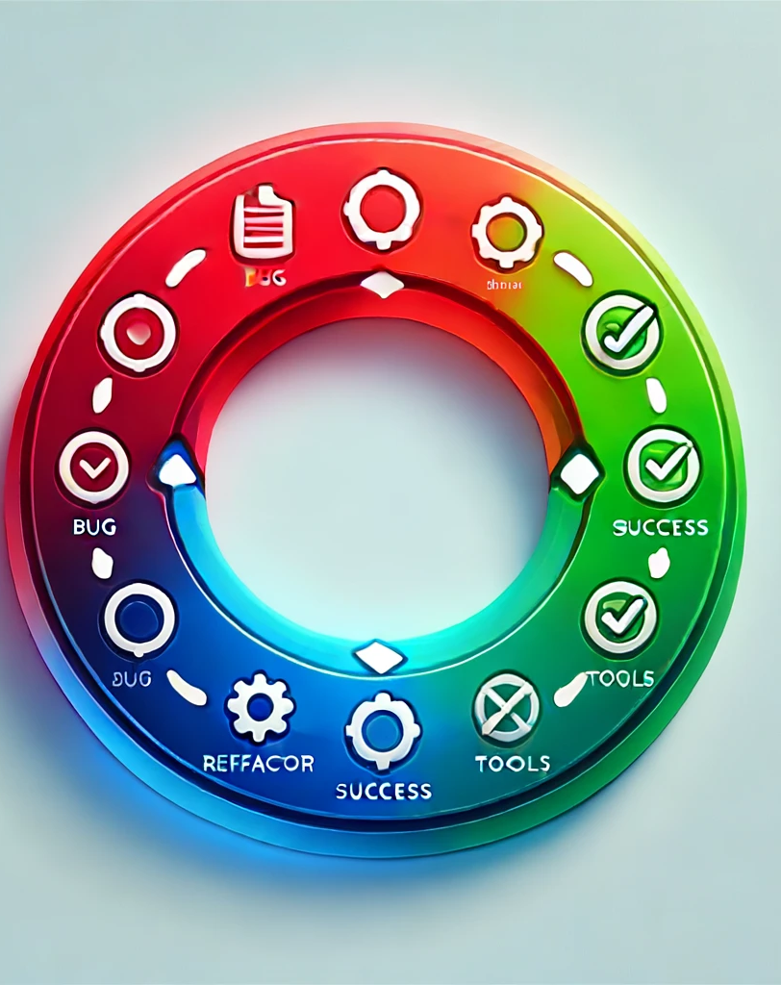
TDD Cycle: Red, Green, Refactor
Red: Write a failing test
Green: Make the test pass
Refactor: Improve the code
Notes:
(9:55 - 10:00) 5 minutes
**One Sentence Summary**
- "Understand the TDD cycle with its three essential steps: writing a failing test, making the test pass, and then refactoring the code."
**Detailed Notes:**
- **Introduction**:
- Explain that Test-Driven Development (TDD) is a software development process that relies on the repetition of a very short development cycle.
- **Red: Write a Failing Test**:
- **Explanation**:
- The first step is to write a test for the next bit of functionality you want to add. Initially, this test will fail because the functionality is not yet implemented.
- Emphasize that writing the test first ensures that the code is testable and that requirements are clear and verifiable.
- **Example**:
- "For example, if you’re implementing a function to check if a number is even, you would first write a test case that calls this function with an input like 3 and expects the result to be false."
- **Green: Make the Test Pass**:
- **Explanation**:
- The next step is to write the minimal amount of code necessary to make the test pass. This step is focused on implementing the functionality quickly without worrying about the quality of the code.
- Highlight that the aim is to have all tests pass, confirming that the new functionality works as intended.
- **Example**:
- "Continuing from our example, you would then implement the `isEven` function to return false when the input is 3, just enough to make the test pass."
- **Refactor: Improve the Code**:
- **Explanation**:
- Once the test passes, you can refactor the code to improve its structure and readability. This step is about cleaning up the code while ensuring that all tests still pass.
- Mention that refactoring is a crucial step to maintain code quality and make the codebase more maintainable.
- **Example**:
- "After the `isEven` function passes the test, you might refactor it to handle all cases, such as `return number % 2 == 0`, making it a proper implementation."
**Background Information**:
- **Test-Driven Development (TDD)**:
- TDD was popularized by Kent Beck as part of the Extreme Programming (XP) methodology in the late 1990s. It emphasizes writing tests before writing the actual code to ensure functionality and drive design.
- This approach helps in creating a robust and error-free codebase, making maintenance and further development easier.
**Example**:
- **Real-world Scenario**:
- "In a recent project, we adopted TDD for developing a complex feature. By writing the tests first, we ensured that the requirements were well understood and that the code was reliable from the outset. This approach significantly reduced the number of bugs and made the codebase more maintainable."

Slide 12
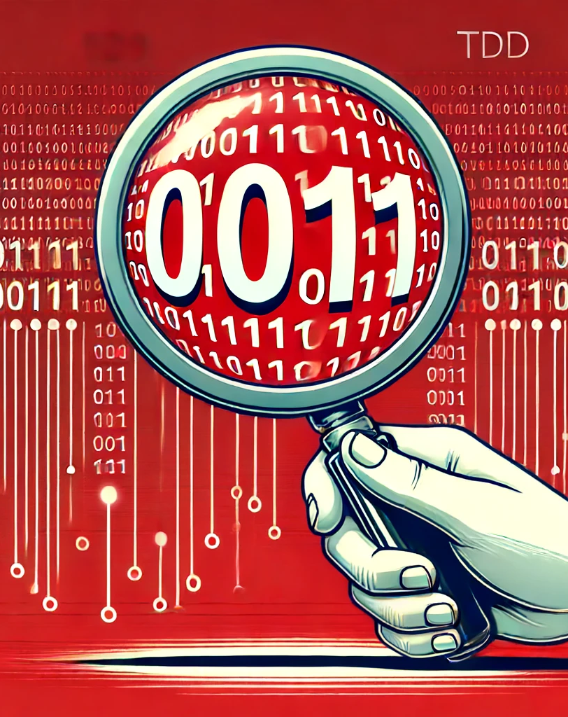
TDD Step 1: Red - Write a Failing Test
Define the functionality
Write a test case that fails
Notes:
(10:00 - 10:05) 5 minutes
**One Sentence Summary**
- "The first step in TDD is to write a test for the desired functionality that initially fails, ensuring the code to be developed is testable and meets the requirements."
**Detailed Notes:**
- **Introduction**:
- Explain that the first step in the TDD cycle is to write a test for the next piece of functionality you want to add.
- **Define the Functionality**:
- **Explanation**:
- Clearly define the functionality you are about to implement. This clarity helps in writing a precise test case.
- **Example**:
- "If the functionality is to check if a number is even, you would define that the function `isEven` should return true for even numbers and false for odd numbers."
- **Write a Test Case that Fails**:
- **Explanation**:
- Write a test case based on the defined functionality. Since the functionality is not yet implemented, this test will fail.
- Highlight that starting with a failing test ensures that the test is meaningful and that the upcoming code implementation is necessary.
- **Example**:
- "Write a test case such as: `assertFalse(isEven(3))`. Since `isEven` is not implemented, this test will fail, signaling the need for code to be written."
**Background Information**:
- **Importance of Failing Tests**:
- Writing the test first and seeing it fail confirms that the test is effective and that the functionality needs to be developed. This step sets a clear goal for the next coding phase.
**Example**:
- **Real-world Scenario**:
- "In a recent project, we needed to add a new feature to an existing application. By writing a failing test first, we ensured that the requirements were well-understood and that the upcoming code would meet those requirements. This approach helped in catching edge cases early and avoiding rework later."

Slide 13

TDD Step 2: Green - Make the Test Pass
Implement the minimal code
Ensure the test passes
Notes:
(10:05 - 10:10) 5 minutes
**One Sentence Summary**
- "The second step in TDD is to implement the minimal code necessary to make the failing test pass, focusing on functionality rather than optimization."
**Detailed Notes:**
- **Introduction**:
- Explain that the second step in the TDD cycle is to write just enough code to make the failing test pass.
- **Implement the Minimal Code**:
- **Explanation**:
- Focus on writing the simplest code that fulfills the requirements defined by the test.
- The goal is to achieve functionality without worrying about optimization or code quality at this stage.
- **Example**:
- "For the `isEven` function, you might initially write: `function isEven(number) { return number === 3 ? false : true; }`. This simplistic code will make the specific test case pass."
- **Ensure the Test Passes**:
- **Explanation**:
- Run the test suite to confirm that the new code makes the failing test pass.
- This validation ensures that the functionality is correctly implemented as per the test requirements.
- **Example**:
- "Run the test case `assertFalse(isEven(3))` and verify that it now passes, indicating that the initial implementation is correct."
**Background Information**:
- **Focus on Functionality**:
- At this stage, the primary focus is to get the test to pass with the simplest solution. Refinements and optimizations come later during the refactoring step.
**Example**:
- **Real-world Scenario**:
- "When adding a new feature to a codebase, we initially wrote minimal code to pass the tests. This approach allowed us to quickly validate our logic and ensured that our focus remained on meeting the requirements."

Slide 14

TDD Step 3: Refactor - Improve the Code
Clean up the code
Ensure all tests pass
Notes:
(10:10 - 10:15) 5 minutes
**One Sentence Summary**
- "The third step in TDD is to refactor the code to improve its structure and readability while ensuring all tests continue to pass."
**Detailed Notes:**
- **Introduction**:
- Explain that the third step in the TDD cycle is to refactor the code to improve its quality while ensuring that all tests still pass.
- **Clean Up the Code**:
- **Explanation**:
- Refactor the code to improve its structure, readability, and maintainability.
- Apply best practices and design principles to ensure that the code is clean and efficient.
- **Example**:
- "Refactor the `isEven` function to a more general solution: `function isEven(number) { return number % 2 === 0; }`. This code is cleaner and handles all cases correctly."
- **Ensure All Tests Pass**:
- **Explanation**:
- Run the test suite again to confirm that all tests, including the new one, pass after the refactor.
- This step ensures that the refactoring process has not introduced any new issues.
- **Example**:
- "Run the test case `assertFalse(isEven(3))` along with other tests to verify that they all pass, confirming that the code is functioning as expected after refactoring."
**Background Information**:
- **Importance of Refactoring**:
- Refactoring is crucial to maintain a clean and maintainable codebase. It helps in improving code quality without changing its external behavior.
**Example**:
- **Real-world Scenario**:
- "In our projects, we follow the refactoring step diligently to ensure that our code remains clean and maintainable. By continuously improving the code structure, we make it easier to add new features and fix bugs in the future."

Slide 15
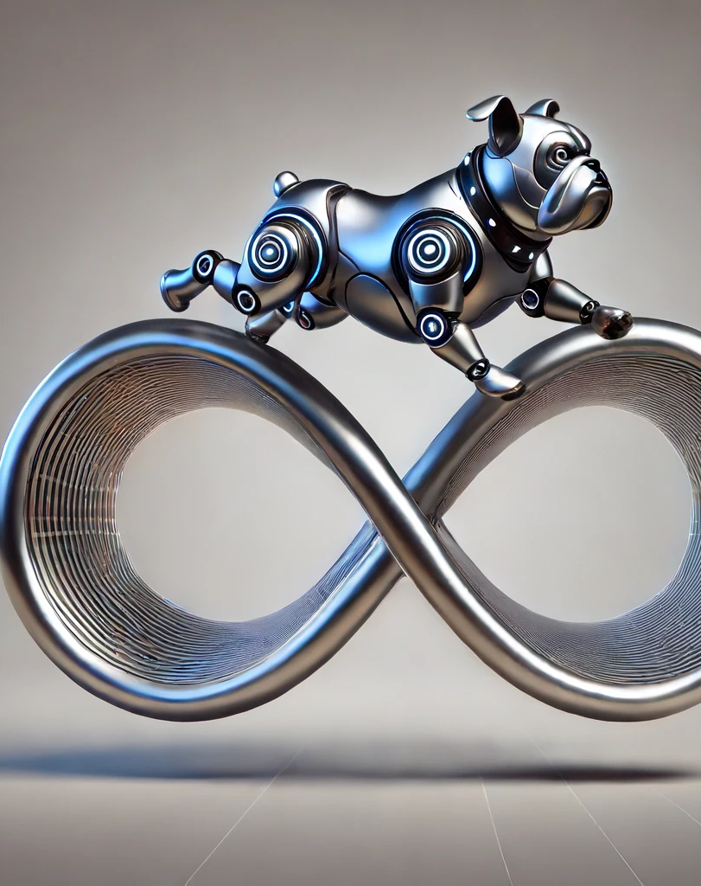
Repeating the Cycle
Add additional tests
Follow the Red, Green, Refactor steps
Notes:
(10:15 - 10:20) 5 minutes
**One Sentence Summary**
- "In TDD, repeating the cycle with additional tests ensures comprehensive coverage and continuous improvement of the code."
**Detailed Notes**:
- **Introduction**:
- Explain that Test-Driven Development (TDD) involves iteratively repeating the cycle of writing tests, making them pass, and refactoring.
- **Add Additional Tests**:
- **Explanation**:
- After implementing the initial functionality, identify new requirements or edge cases and write corresponding tests.
- Each new test should initially fail, highlighting the need for additional code or modifications.
- **Example**:
- "For the Fizz Buzz problem, after handling numbers divisible by 3 (Fizz) and 5 (Buzz), add a test for numbers divisible by both 3 and 5 (FizzBuzz): `Assert.AreEqual("FizzBuzz", fizzBuzz.GetOutput(15));`."
- **Follow the Red, Green, Refactor Steps**:
- **Explanation**:
- Continue the TDD cycle by following the Red, Green, Refactor steps for each new test.
- This approach ensures that new functionality is added incrementally and tested thoroughly.
- **Example**:
- "Implement the code to handle the new test case, make it pass, and then refactor the code to maintain its quality. For example, update the `GetOutput` method to return 'FizzBuzz' for numbers divisible by 15."
**Background Information**:
- **Iterative Development**:
- TDD promotes iterative development, where code is written incrementally and tested continuously. This method helps in catching errors early and ensures that the codebase remains robust and maintainable.
**Example**:
- **Real-world Scenario**:
- "In a project where we used TDD, we consistently added tests for new features and edge cases. This iterative approach allowed us to build a reliable and well-tested codebase, with each test ensuring that new code did not introduce regressions or bugs."

Slide 16
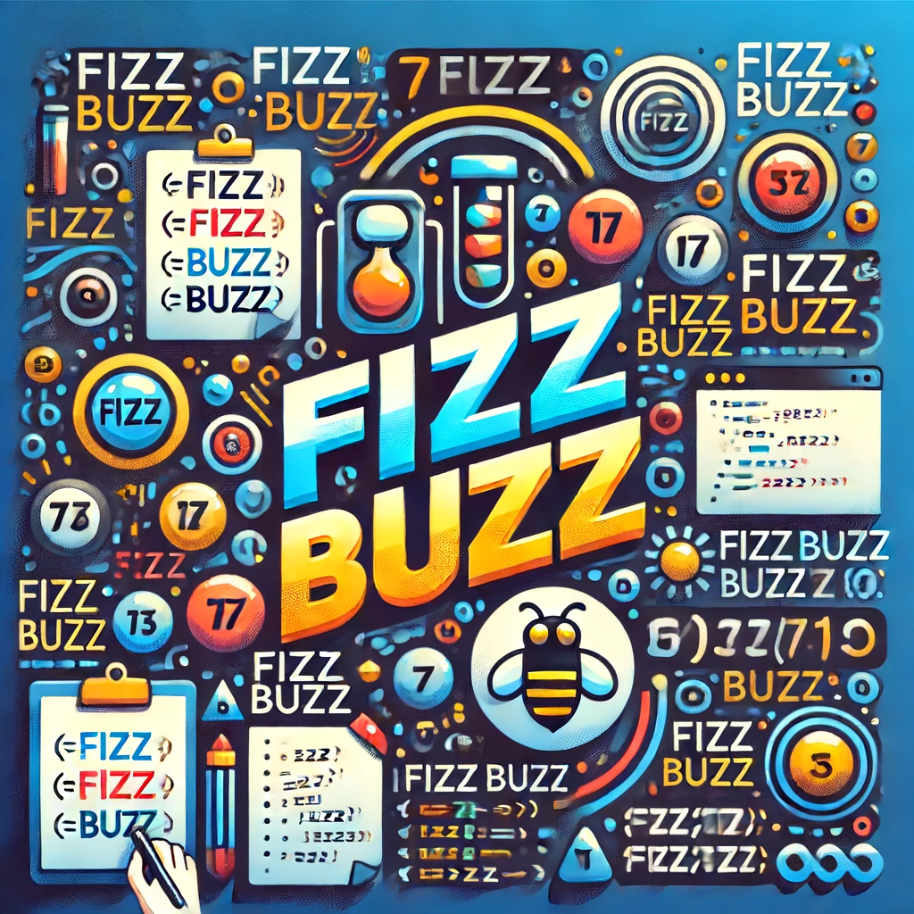
Overview of the Fizz Buzz Problem
Program prints numbers from 1 to 100
Multiples of three: print 'Fizz'
Multiples of five: print 'Buzz'
Multiples of both: print 'FizzBuzz’
Notes:
(10:20 - 10:25) 5 minutes
**One Sentence Summary**
- "Learn how to apply the TDD cycle to solve the classic Fizz Buzz problem, reinforcing the concepts of writing tests, implementing code, and refactoring."
**Detailed Notes**:
- **Introduction**:
- Explain that the Fizz Buzz problem is a simple yet effective exercise to practice Test-Driven Development (TDD) principles.
- **Overview of the Fizz Buzz Problem**:
- **Description**:
- Write a program that prints numbers from 1 to 100.
- For multiples of three, print "Fizz" instead of the number.
- For multiples of five, print "Buzz".
- For numbers which are multiples of both three and five, print "FizzBuzz".
- **Example**:
- "If a number is divisible by 3, print 'Fizz'. If divisible by 5, print 'Buzz'. If divisible by both, print 'FizzBuzz'. For all other numbers, print the number itself."
- **Applying the TDD Cycle**:
- **Red: Write a Failing Test**:
- Start by writing a test case for one of the requirements, such as checking if a number is divisible by 3 and should print "Fizz".
- **Green: Make the Test Pass**:
- Implement the simplest code to make the test pass, such as returning "Fizz" for numbers divisible by 3.
- **Refactor: Improve the Code**:
- Refactor the code to handle other cases and improve the overall structure, ensuring that all tests pass.
**Background Information**:
- **Fizz Buzz Kata**:
- The Fizz Buzz kata is a well-known exercise used to practice basic programming and TDD principles. It helps in understanding how to break down problems and apply TDD steps systematically.
**Example**:
- **Implementing Fizz Buzz**:
- "We will start by writing a test for the case where the number is divisible by 3. Next, we will implement the code to make this test pass. Finally, we will refactor the code to handle other cases like multiples of 5 and 15, ensuring that all tests pass."

Slide 17

Practical Exercise: Fizz Buzz Kata
C-Sharp/01-fizz-buzz
Notes:
(10:25 - 10:55) 30 minutes
**One Sentence Summary**
- "Engage in a practical exercise to apply the TDD cycle to the Fizz Buzz problem, reinforcing the concepts of writing tests, implementing code, and refactoring."
**Detailed Notes**:
- **Introduction**:
- Explain that this practical exercise will guide participants through the Fizz Buzz problem using the TDD cycle.
- **Writing the First Test (Red)**:
- **Explanation**:
- Start by writing a test case for the first requirement. For example, a test to check if a number is divisible by 3 should print "Fizz".
- **Example**:
- "Write a test case such as: `Assert.AreEqual("Fizz", fizzBuzz.GetOutput(3));`. This test will initially fail because the `GetOutput` method is not implemented yet."
- **Making the Test Pass (Green)**:
- **Explanation**:
- Implement the minimal code required to make the test pass. Focus on functionality without worrying about optimization.
- **Example**:
- "Implement the `GetOutput` method to return 'Fizz' for the number 3: `public string GetOutput(int number) { return number == 3 ? "Fizz" : number.ToString(); }`. This should make the test pass."
- **Refactoring (Refactor)**:
- **Explanation**:
- Refactor the code to improve its structure and readability while ensuring all tests pass.
- **Example**:
- "Refactor the `GetOutput` method to handle other cases, such as numbers divisible by 5 and 15: `public string GetOutput(int number) { if (number % 15 == 0) return "FizzBuzz"; if (number % 3 == 0) return "Fizz"; if (number % 5 == 0) return "Buzz"; return number.ToString(); }`."
- **Repeating the Cycle**:
- **Explanation**:
- Continue adding tests for other requirements and follow the TDD cycle (Red, Green, Refactor) for each new test.
- **Example**:
- "Add a test case for numbers divisible by 5: `Assert.AreEqual("Buzz", fizzBuzz.GetOutput(5));`. Implement the minimal code to make it pass and then refactor as needed."
**Background Information**:
- **TDD Cycle**:
- The TDD cycle (Red, Green, Refactor) helps in developing code that is well-tested, maintainable, and of high quality. Practicing with exercises like Fizz Buzz reinforces these principles.
**Example**:
- **Hands-On Experience**:
- "By working through the Fizz Buzz problem using the TDD cycle, you will gain hands-on experience in writing tests first, implementing code to make the tests pass, and refactoring to improve code quality. This practice will help you understand and internalize the TDD process."
---
Let's review this slide. Are you satisfied with the content and notes, or would you like to make any adjustments before proceeding?

Slide 18

Using ChatGPT as an Assistant
Real-time coding help
Debugging assistance
Learning new concepts
Notes:
(10:55 - 11:00) 5 minutes
**One Sentence Summary**
- "Learn how to utilize ChatGPT as an assistant for real-time coding help, debugging, and learning new programming concepts."
**Detailed Notes**:
- **Introduction**:
- Explain that ChatGPT can be a valuable tool for developers by providing real-time assistance in various coding tasks.
- **Real-time Coding Help**:
- **Explanation**:
- ChatGPT can help with writing code, understanding syntax, and providing code snippets based on natural language queries.
- **Example**:
- "You can ask ChatGPT to generate a code snippet for a specific task, such as sorting an array or connecting to a database."
- **Debugging Assistance**:
- **Explanation**:
- ChatGPT can assist in diagnosing and resolving errors in the code by analyzing error messages and suggesting possible fixes.
- **Example**:
- "If you encounter a null pointer exception, you can describe the issue to ChatGPT, and it will provide potential solutions and explanations."
- **Learning New Concepts**:
- **Explanation**:
- Use ChatGPT to learn new programming concepts, best practices, and explore unfamiliar technologies.
- **Example**:
- "You can ask ChatGPT to explain the concept of closures in JavaScript or the principles of RESTful API design."
**Background Information**:
- **ChatGPT**:
- ChatGPT, developed by OpenAI, is a conversational AI model capable of understanding and generating human-like text. It can be used for a variety of tasks, including coding, debugging, and learning.
**Example**:
- **Using ChatGPT for Debugging**:
- "During a recent project, I encountered a bug that was difficult to diagnose. I described the issue to ChatGPT, and it provided a detailed explanation of possible causes and steps to resolve the problem. This saved me a significant amount of time and helped me understand the root cause of the issue."

Slide 19

Pair Programming Exercise: Duration Converter
C-Sharp/02-duration-converter
Notes:
(11:00 - 11:30) 30 minutes
**One Sentence Summary**
- "Engage in a pair programming exercise to implement a Duration Converter using TDD principles, with assistance from GitHub Copilot and ChatGPT."
**Detailed Notes**:
- **Introduction**:
- Explain that this exercise will focus on implementing a Duration Converter function using TDD principles.
- Emphasize the importance of collaboration and using AI tools to enhance productivity.
- **Work in Pairs to Implement Duration Converter**:
- **Explanation**:
- Participants will work in pairs to tackle the Duration Converter problem.
- Encourage collaboration and communication to solve the problem effectively.
- **Example**:
- "One participant can focus on writing the tests, while the other implements the code to make the tests pass. Switch roles after each test cycle."
- **Apply TDD Principles**:
- **Explanation**:
- Follow the TDD cycle: Red (write a failing test), Green (make the test pass), Refactor (improve the code).
- **Example**:
- "Start by writing a test case for converting a simple duration string, such as '1h 30m'. Implement the minimal code to pass the test, then refactor to handle more complex cases."
- **Use GitHub Copilot and ChatGPT for Assistance**:
- **Explanation**:
- Leverage GitHub Copilot to generate code suggestions and autocomplete.
- Use ChatGPT to get explanations, debugging help, and additional code snippets.
- **Example**:
- "If you're unsure how to handle a specific edge case, ask ChatGPT for suggestions or use GitHub Copilot to generate potential solutions."
**Background Information**:
- **Duration Converter**:
- The task involves writing a function that converts a string representing a duration (e.g., "1h 30m") into a total number of minutes or another desired format.
- **Pair Programming**:
- Pair programming is an agile software development technique where two programmers work together at one workstation. It promotes collaboration, knowledge sharing, and higher code quality.
**Example**:
- **Collaborative Problem Solving**:
- "In a recent workshop, participants found that working in pairs not only helped them solve problems more efficiently but also provided opportunities to learn from each other. Using tools like GitHub Copilot and ChatGPT enhanced their coding experience by offering real-time assistance and suggestions."

Slide 20

Introduction to Software Craftsmanship
Importance of clean code
Continuous improvement
Core principles
Notes:
(11:30 - 11:35) 5 minutes
**One Sentence Summary**
- "Understand the importance of software craftsmanship, focusing on writing clean code and continuous improvement through core principles."
**Detailed Notes**:
- **Introduction**:
- Explain that software craftsmanship is a movement aimed at improving the quality of software through best practices and a focus on professionalism.
- **Importance of Clean Code**:
- **Explanation**:
- Clean code is easy to read, understand, and maintain. It reduces technical debt and makes it easier to add new features or fix bugs.
- **Example**:
- "Writing clean code involves using meaningful variable names, keeping functions short and focused, and adhering to consistent coding standards."
- **Continuous Improvement**:
- **Explanation**:
- Continuous improvement is about constantly seeking ways to enhance the codebase and the development process. It involves regular refactoring and learning from past experiences.
- **Example**:
- "Incorporate regular code reviews and refactoring sessions to identify and address code smells, improving code quality over time."
- **Core Principles**:
- **Explanation**:
- Core principles of software craftsmanship include SOLID principles, DRY (Don't Repeat Yourself), and YAGNI (You Aren't Gonna Need It).
- **Example**:
- "Adhering to the SOLID principles helps in creating a flexible and maintainable codebase. For example, the Single Responsibility Principle ensures that a class has only one reason to change, making it easier to manage."
**Background Information**:
- **Software Craftsmanship**:
- The Software Craftsmanship Manifesto was introduced in 2009 as an extension to the Agile Manifesto, emphasizing the value of well-crafted software and the importance of professional development in software engineering.
**Example**:
- **Real-world Scenario**:
- "In a previous project, we adopted the practices of software craftsmanship by conducting regular code reviews and following the SOLID principles. This approach significantly improved our code quality and reduced the number of bugs, leading to a more maintainable and scalable application."

Slide 21

SOLID Principles Overview
Single Responsibility Principle
Open/Closed Principle
Liskov Substitution Principle
Interface Segregation Principle
Dependency Inversion Principle
Notes:
(11:35 - 11:40) 5 minutes
**One Sentence Summary**
- "An overview of the SOLID principles, which are fundamental to writing clean, maintainable, and scalable code."
**Detailed Notes**:
- **Introduction**:
- Explain that SOLID principles are a set of design principles aimed at making software designs more understandable, flexible, and maintainable.
- **Single Responsibility Principle (SRP)**:
- **Explanation**:
- A class should have only one reason to change, meaning it should have only one job or responsibility.
- **Example**:
- "A class handling user authentication should not also be responsible for sending email notifications."
- **Open/Closed Principle (OCP)**:
- **Explanation**:
- Software entities should be open for extension but closed for modification. You should be able to add new functionality without changing existing code.
- **Example**:
- "Adding new payment methods to a payment processing system without altering the existing code for other payment methods."
- **Liskov Substitution Principle (LSP)**:
- **Explanation**:
- Objects of a superclass should be replaceable with objects of a subclass without affecting the correctness of the program.
- **Example**:
- "A function that works with a base class should work with any derived class, such as a base class `Shape` and derived classes `Circle` and `Square`."
- **Interface Segregation Principle (ISP)**:
- **Explanation**:
- No client should be forced to depend on methods it does not use. Interfaces should be specific to clients' needs.
- **Example**:
- "Separate interfaces for printable and scanable functionalities rather than a single multifunction interface."
- **Dependency Inversion Principle (DIP)**:
- **Explanation**:
- High-level modules should not depend on low-level modules but on abstractions. Abstractions should not depend on details.
- **Example**:
- "A high-level module for processing orders should depend on an abstract payment processor interface, not on a concrete payment processor class."
**Background Information**:
- **SOLID Principles**:
- Introduced by Robert C. Martin, also known as Uncle Bob, the SOLID principles help in creating a robust and maintainable object-oriented design.
**Example**:
- **Real-world Scenario**:
- "In a project where we applied SOLID principles, the codebase became significantly easier to maintain and extend. For instance, by adhering to the Open/Closed Principle, we were able to add new features without modifying existing code, reducing the risk of introducing bugs."

Slide 22

Single Responsibility Principle
A class should have only one reason to change
Focus on a single job or responsibility
Notes:
(11:40 - 11:45) 5 minutes
**One Sentence Summary**
- "The Single Responsibility Principle states that a class should have only one reason to change, focusing on a single job or responsibility."
**Detailed Notes**:
- **Introduction**:
- Explain that the Single Responsibility Principle (SRP) is about ensuring that a class or module has only one reason to change.
- **A Class Should Have Only One Reason to Change**:
- **Explanation**:
- SRP emphasizes that a class should be responsible for only one part of the functionality provided by the software, and that responsibility should be entirely encapsulated by the class.
- **Example**:
- "A class handling user authentication should not also be responsible for sending email notifications. Instead, there should be separate classes for authentication and email notifications."
- **Focus on a Single Job or Responsibility**:
- **Explanation**:
- By focusing on a single responsibility, classes become smaller, easier to understand, and more maintainable. It also makes them easier to test and debug.
- **Example**:
- "Consider a class `UserAuthenticator` that handles only user authentication. This class should not include methods for logging or emailing users. Instead, these should be handled by separate classes like `Logger` and `EmailSender`."
**Background Information**:
- **Single Responsibility Principle (SRP)**:
- SRP is one of the five SOLID principles of object-oriented design, introduced by Robert C. Martin (Uncle Bob). It aims to reduce the complexity of classes and enhance code maintainability.
**Example**:
- **Real-world Scenario**:
- "In a project, we had a `UserManager` class that was initially handling multiple responsibilities, including user authentication, logging, and email notifications. By refactoring the code to adhere to SRP, we created separate classes for each responsibility. This made the codebase easier to manage and extend."
**Personal Anecdote**:
- **Hammer Example**:
- "Think of a hammer as an example of SRP in action. A hammer is designed for one job: to drive nails into wood or other materials. It doesn't perform other tasks like measuring or cutting, which are the responsibilities of a tape measure or a saw. Similarly, in software, a class should be designed to do one thing well."

Slide 23

Open/Closed Principle
Open for extension
Closed for modification
Notes:
(11:45 - 11:50) 5 minutes
**One Sentence Summary**
- "The Open/Closed Principle states that software entities should be open for extension but closed for modification, allowing for new functionality without altering existing code."
**Detailed Notes**:
- **Introduction**:
- Explain that the Open/Closed Principle (OCP) is about designing software entities such as classes, modules, and functions to allow their behavior to be extended without modifying their source code.
- **Open for Extension**:
- **Explanation**:
- Software entities should be extendable to allow for new functionality. This can be achieved through mechanisms like inheritance, interfaces, and abstract classes.
- **Example**:
- "In a payment processing system, you can extend the system to support new payment methods by creating new classes that implement a common `PaymentProcessor` interface, without altering the existing classes."
- **Closed for Modification**:
- **Explanation**:
- Once a class or module has been developed and tested, its source code should not be changed to add new behavior. This helps maintain stability and prevents the introduction of bugs.
- **Example**:
- "If the `PaymentProcessor` interface is already defined and used by the system, adding a new payment method like `BitcoinPayment` can be done by creating a new class `BitcoinPaymentProcessor` that implements `PaymentProcessor`, without changing the existing code for other payment methods."
**Background Information**:
- **Open/Closed Principle (OCP)**:
- OCP is one of the SOLID principles of object-oriented design, formulated by Bertrand Meyer. It aims to make software systems more maintainable and scalable by preventing changes to existing, tested code.
**Example**:
- **Real-world Scenario**:
- "In a previous project, we followed OCP by using interfaces and abstract classes for core functionalities. When we needed to add new features, we extended the existing codebase without modifying the original classes. This approach minimized the risk of introducing bugs and allowed us to add new features more efficiently."

Slide 24

Liskov Substitution Principle
Subtypes must be substitutable for their base types
Ensure consistent behavior
Notes:
(11:50 - 11:55) 5 minutes
**One Sentence Summary**
- "The Liskov Substitution Principle ensures that objects of a superclass should be replaceable with objects of a subclass without affecting the correctness of the program."
**Detailed Notes**:
- **Introduction**:
- Explain that the Liskov Substitution Principle (LSP) is about ensuring that derived classes (subclasses) can be substituted for their base classes (superclasses) without altering the correctness of the program.
- **Subtypes Must Be Substitutable for Their Base Types**:
- **Explanation**:
- LSP states that functions that use pointers or references to a base class must be able to use objects of a derived class without knowing it. The derived class should extend the base class without changing its behavior.
- **Example**:
- "If you have a base class `Bird` with a method `fly()`, and a subclass `Sparrow` that extends `Bird`, any instance of `Sparrow` should be usable wherever `Bird` is expected, without causing errors or unexpected behavior."
- **Ensure Consistent Behavior**:
- **Explanation**:
- Subclasses should not override the base class's behavior in a way that violates the expectations established by the base class. This means ensuring that preconditions, postconditions, and invariants are maintained.
- **Example**:
- "If a subclass `Penguin` extends `Bird`, but `Penguin` cannot fly, using `Penguin` where `Bird` is expected would break the LSP if the `fly()` method is called. Instead, `Penguin` should not extend `Bird`, or the design should be reconsidered."
**Background Information**:
- **Liskov Substitution Principle (LSP)**:
- Introduced by Barbara Liskov in a 1987 conference keynote, LSP is a fundamental principle in object-oriented design that ensures a subclass can stand in for its superclass without affecting the program's behavior.
**Example**:
- **Real-world Scenario**:
- "In a project, we designed a class hierarchy for handling different types of documents. By adhering to LSP, we ensured that each specific document type, such as `WordDocument` and `PdfDocument`, could be used interchangeably where a generic `Document` type was expected. This made our code more flexible and robust."

Slide 25

Interface Segregation Principle
No client should be forced to depend on methods it does not use
Keep interfaces small and focused
Notes:
(11:55 - 12:00) 5 minutes
#### Bullet Points:
- No client should be forced to depend on methods it does not use
- Keep interfaces small and focused
### Presenter Notes:
**One Sentence Summary**
- "The Interface Segregation Principle states that no client should be forced to depend on methods it does not use, promoting small and focused interfaces."
**Detailed Notes**:
- **Introduction**:
- Explain that the Interface Segregation Principle (ISP) is about designing interfaces that are specific to the clients' needs rather than creating large, general-purpose interfaces.
- **No Client Should Be Forced to Depend on Methods It Does Not Use**:
- **Explanation**:
- ISP emphasizes that clients should not be forced to implement or depend on interfaces they do not use. This prevents unnecessary dependencies and keeps the system more modular.
- **Example**:
- "If you have an interface `Printer` with methods `print()` and `scan()`, but a class `SimplePrinter` only needs the `print()` method, `SimplePrinter` should not be forced to implement `scan()`. Instead, create separate interfaces for `Printable` and `Scannable`."
- **Keep Interfaces Small and Focused**:
- **Explanation**:
- Design interfaces to be small and focused on specific tasks. This makes them easier to implement and maintain, and allows for greater flexibility in the system.
- **Example**:
- "Instead of a single `Device` interface with methods for `print()`, `scan()`, `fax()`, and `copy()`, create smaller interfaces like `Printable`, `Scannable`, `Faxable`, and `Copiable` to allow classes to implement only the methods they need."
**Background Information**:
- **Interface Segregation Principle (ISP)**:
- ISP is one of the SOLID principles of object-oriented design, introduced by Robert C. Martin. It promotes the use of small, client-specific interfaces over large, general-purpose interfaces.
**Example**:
- **Real-world Scenario**:
- "In a project where we needed to integrate various peripheral devices, we initially had a large interface that combined multiple functionalities. This led to complex implementations and dependencies. By applying ISP, we refactored the code into smaller, focused interfaces, which simplified the implementation and improved code maintainability."

Slide 26

Dependency Inversion Principle
High-level modules should not depend on low-level modules
Depend on abstractions, not concretions
Notes:
(12:00 - 12:05) 5 minutes
**One Sentence Summary**
- "The Dependency Inversion Principle states that high-level modules should not depend on low-level modules; both should depend on abstractions."
**Detailed Notes**:
- **Introduction**:
- Explain that the Dependency Inversion Principle (DIP) is about reversing the conventional dependency relationships in object-oriented design.
- **High-level Modules Should Not Depend on Low-level Modules**:
- **Explanation**:
- DIP emphasizes that high-level modules, which contain complex business logic, should not depend on low-level modules, which handle more detailed operations. Instead, both should depend on abstractions such as interfaces or abstract classes.
- **Example**:
- "A high-level module for processing orders should not depend directly on a low-level module for sending emails. Instead, both should depend on an interface `EmailService` that abstracts the email sending functionality."
- **Depend on Abstractions, Not Concretions**:
- **Explanation**:
- By depending on abstractions, changes in low-level modules do not affect high-level modules. This makes the system more flexible and easier to maintain.
- **Example**:
- "The `OrderProcessor` class should depend on an `IEmailService` interface rather than a concrete `EmailSender` class. This way, you can easily swap out different implementations of `IEmailService` without modifying `OrderProcessor`."
**Background Information**:
- **Dependency Inversion Principle (DIP)**:
- DIP is one of the SOLID principles of object-oriented design, introduced by Robert C. Martin. It aims to decouple software modules, making them more modular, testable, and maintainable.
**Example**:
- **Real-world Scenario**:
- "In a project, we initially had tight coupling between our business logic and data access layers. By applying DIP, we introduced interfaces for data access, which allowed us to switch between different data storage mechanisms without changing the business logic. This significantly improved our system's flexibility and maintainability."

Slide 27
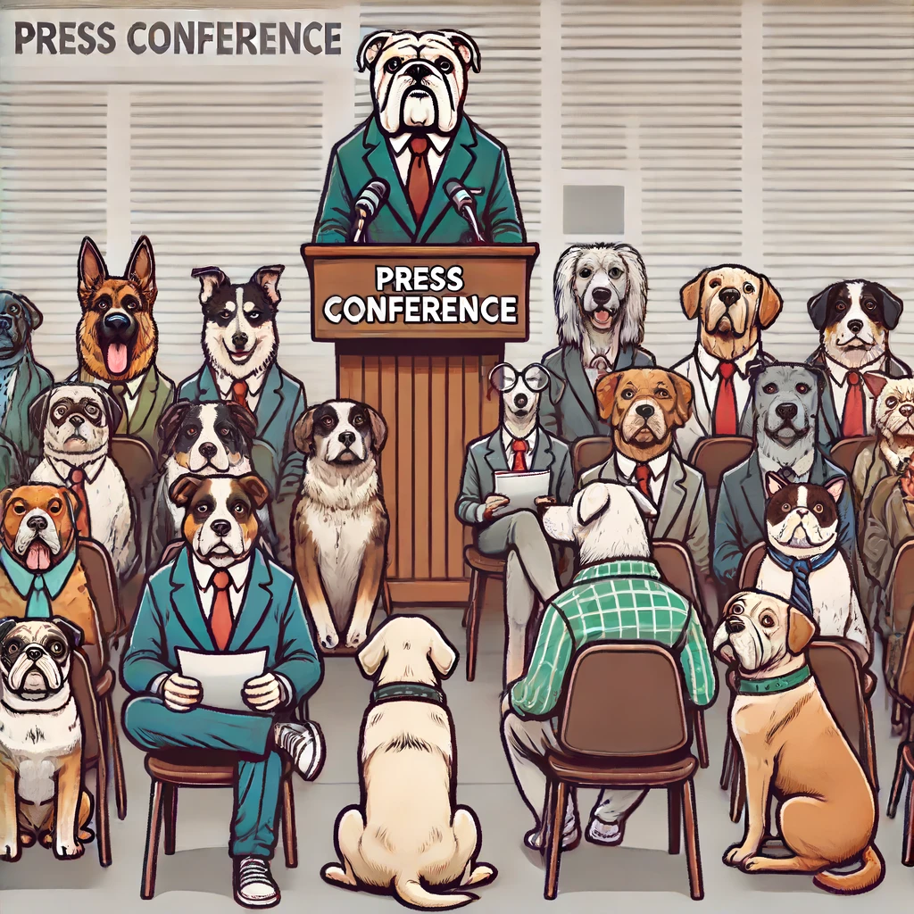
Wrap-Up and Q&A
Summarize key takeaways
Open floor for questions
Preview of the afternoon session
Notes:
(12:05) Up to when people want to take lunch
**One Sentence Summary**
- "Conclude the morning session by summarizing key takeaways, addressing participant questions, and previewing the afternoon session."
**Detailed Notes**:
- **Summarize Key Takeaways from the Morning Session**:
- **Emphasize the Importance of TDD, AI Tools, and Software Craftsmanship Principles**:
- Highlight how TDD helps in building reliable and maintainable code.
- Stress the benefits of integrating AI tools like GitHub Copilot and ChatGPT to enhance productivity and learning.
- Reinforce the value of software craftsmanship principles in writing clean, maintainable, and scalable code.
- **Encourage Continuous Practice and Improvement**:
- Encourage participants to continuously practice the principles and techniques learned.
- Suggest regular use of TDD, leveraging AI tools, and adhering to craftsmanship principles in their projects.
- **Open Floor for Questions and Discussions**:
- **Address Any Challenges Faced by Participants**:
- Invite participants to share any difficulties or challenges they encountered during the session.
- **Provide Solutions and Additional Resources as Needed**:
- Offer solutions to the issues raised and suggest additional resources for further learning.
- **Preview of the Afternoon Session**:
- **Remaining Craftsmanship Principles**:
- Mention that the remaining principles of software craftsmanship will be covered in the afternoon.
- **Focus on the Roman Numeral Calculator Kata**:
- Explain that the next practical exercise will be the Roman Numeral Calculator kata, which will reinforce TDD and refactoring techniques.
- **Introduction to Refactoring Techniques and the Bowling Kata**:
- Highlight that the session will also include an introduction to refactoring techniques and another practical exercise with the Bowling kata.
**Background Information**:
- **Wrap-Up and Q&A**:
- The wrap-up session is crucial for reinforcing the day's learning, addressing any uncertainties, and setting the stage for the next session. It's an opportunity for participants to clarify doubts and for the instructor to gauge the session's effectiveness.
**Example**:
- **Real-world Scenario**:
- "In previous workshops, the wrap-up session proved to be invaluable. Participants shared their experiences and challenges, which led to insightful discussions and deeper understanding. It also helped us tailor the upcoming sessions to better meet their needs."
---
Let's review this slide. Are you satisfied with the content and notes, or would you like to make any adjustments?

